Slide 1













9 Ways Federal Agencies Are Getting Better Results
Thursday, November 29, 2018

Slide 2

Social Media for Today
Event Hashtag:
#FederalStandard

Slide 3
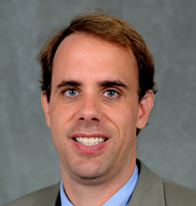
Welcoming Remarks
Michael A. Bailey
Interim Dean,
McCourt School of Public Policy, Georgetown University
@M_A_Bailey ‏

Slide 4
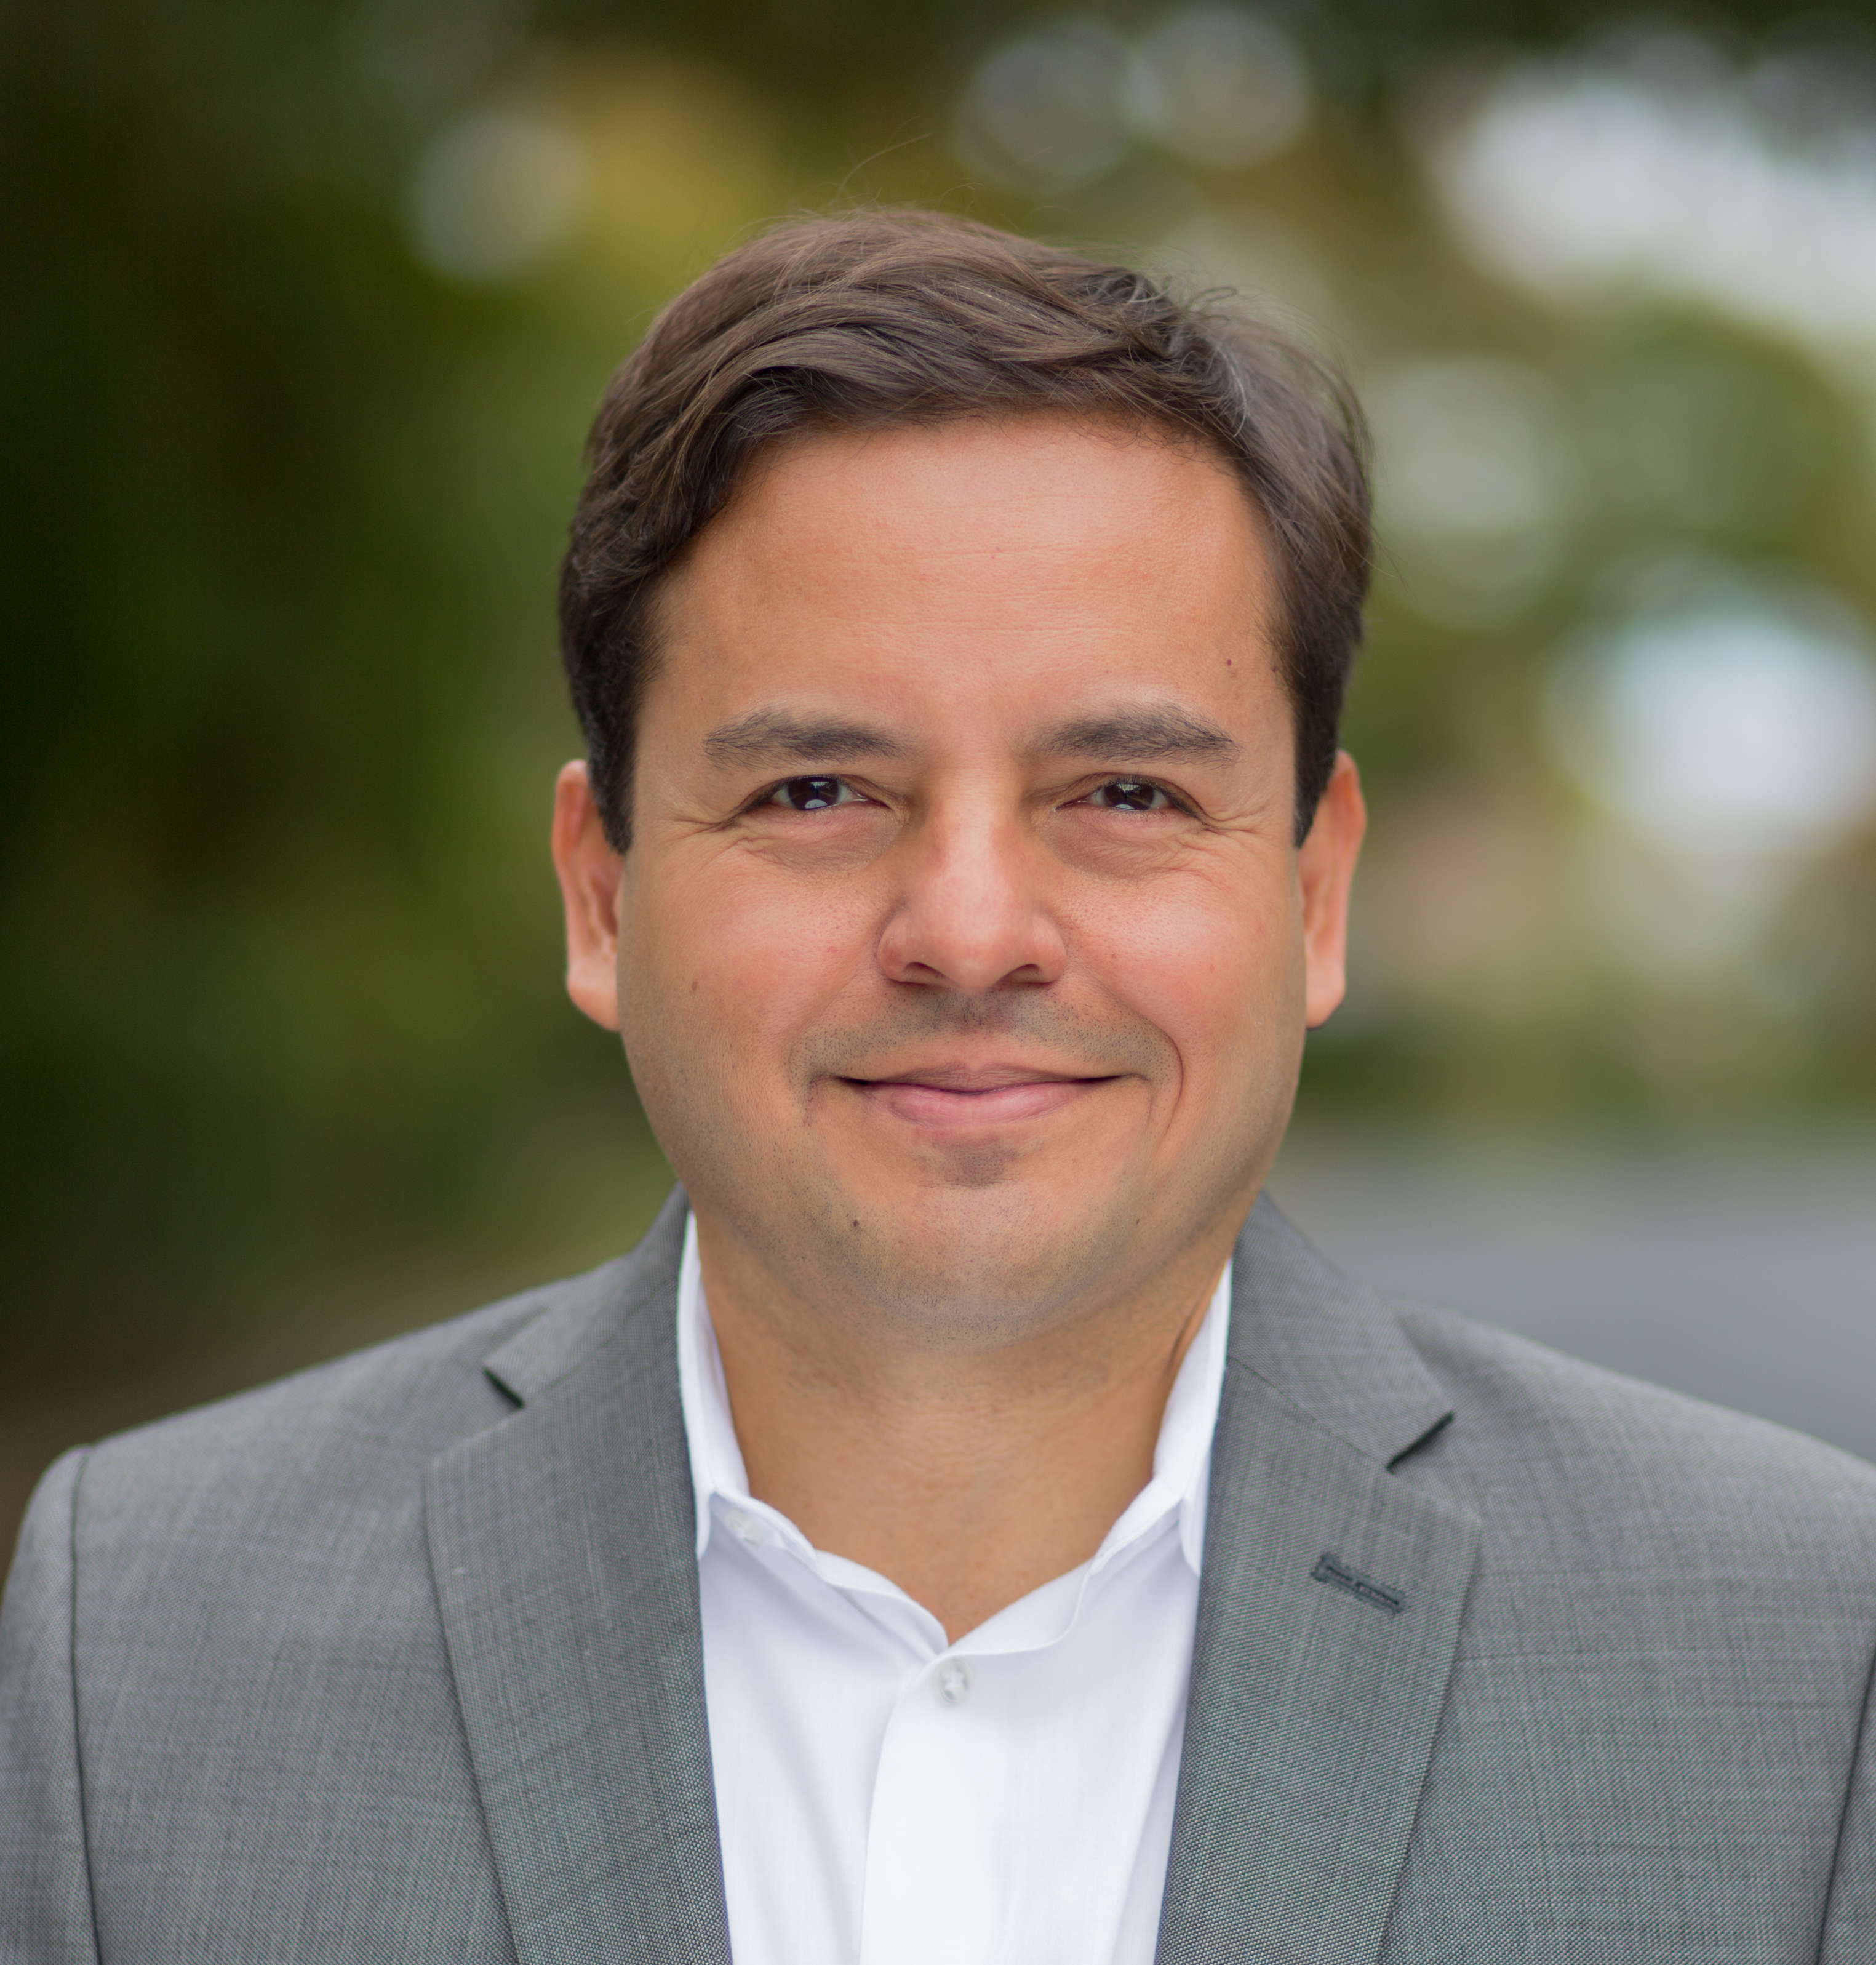
Welcoming Remarks
David Medina
COO and Co-Founder,
Results for America
@DavidMedinaDC

Slide 5

Keynote Remarks
John Bridgeland
President & CEO of Civic;
Former Director of the White House Domestic Policy Council

Slide 6
What Works Awards
Recognition of Federal Leaders Committed
to Data and Evidence

Slide 7
Progress and Momentum
Mary Hyde
Director of Research & Evaluation Corporation for National and Community Service

Slide 8



Biggest Data Accomplishment
Notes:
Watch:
https://www.nationalservice.gov/resources/evaluation/evidence-continuum
Handout CNCS Programs Indicators Checklist

Slide 9
Progress and Momentum
Molly Irwin
Chief Evaluation Officer
U.S. Department of Labor

Slide 11
Progress and Momentum
Susan Jenkins
Director, Office of Performance and Evaluation
Administration for Community Living
U.S. Department of Health
& Human Services

Slide 13
Progress and Momentum
Thomas Kelly
Acting Vice President
for Policy and Evaluation
Millennium Challenge Corporation

Slide 15
Progress and Momentum
Jessica Ramakis
Chief of Staff, Office of Planning Evaluation and Policy Development, and Chief Privacy Officer,
U.S. Department of Education

Slide 16
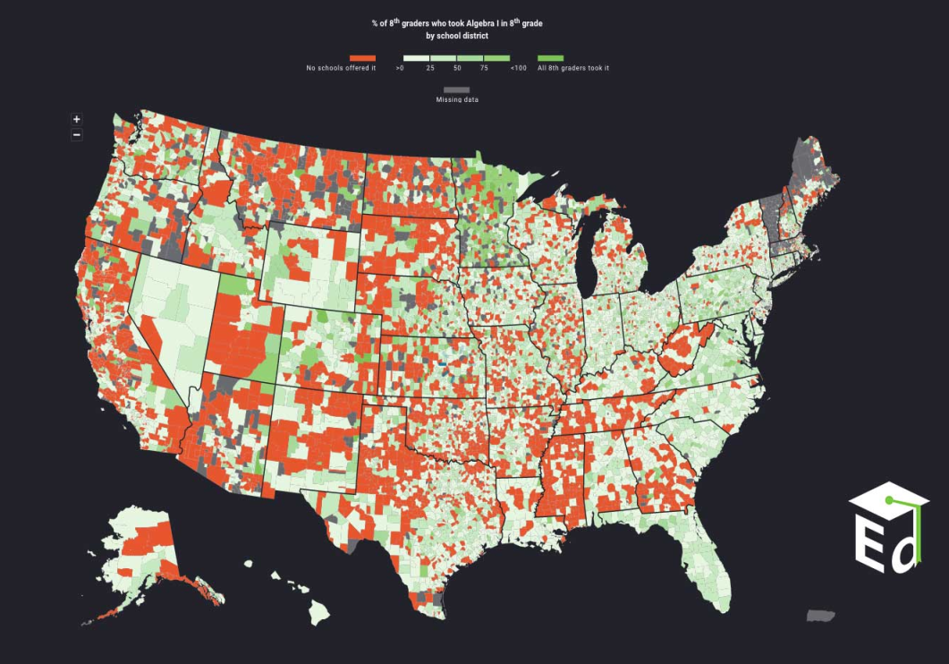
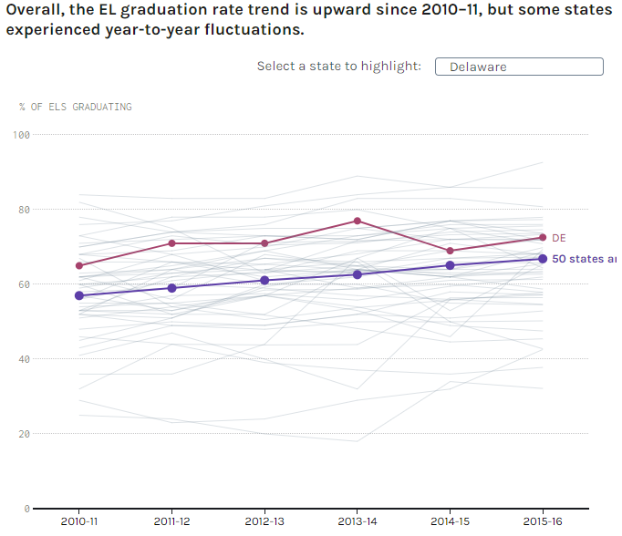
U.S. Department of Education
We developed a series of interactive data stories
to deliver rich data narratives geared towards
non-technical audiences.

Slide 17
Progress and Momentum
Elizabeth Roen
Acting Director, Office of Learning, Evaluation and Research
U.S. Agency for International Development

Slide 18


Slide 19
Progress and Momentum
Emily Schmitt
Deputy Director, Office of Planning,
Research and Evaluation,
Administration for Children and Families
U.S. Department of Health
& Human Services

Slide 20
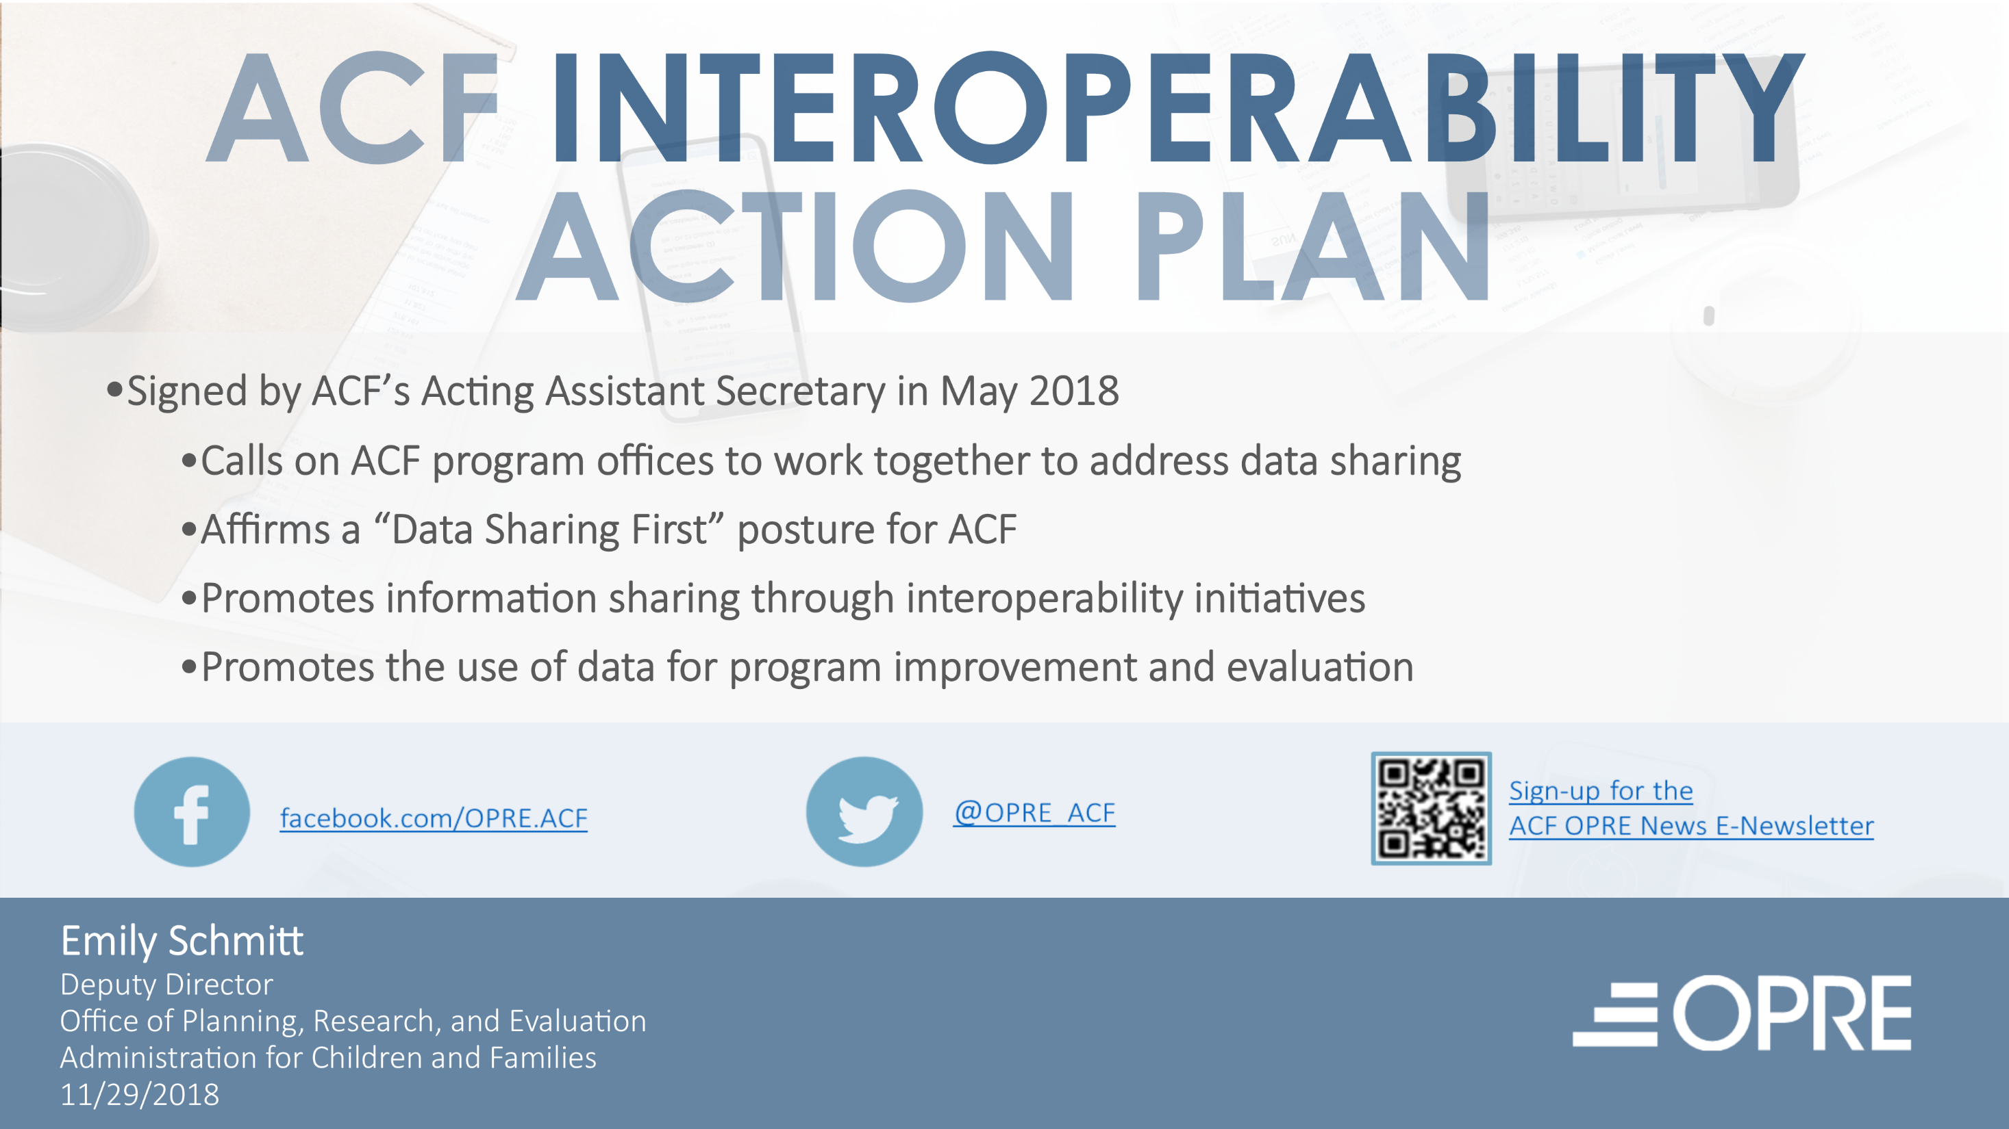

Slide 21
Progress and Momentum
Barry Steffen
Senior Social Science Analyst,
Office of Policy Development & Research
U.S. Department of Housing
& Urban Development

Slide 22

Landlord Acceptance of Housing Vouchers
HUD’s Housing Choice Voucher program relies on participation of private landlords.
Pilot study completed in 2018 used paired testing to measure landlord acceptance rates for HCV tenants in five metro areas.
In three sites less than 31 percent of vouchers were accepted. In two sites with source-of-income anti-discrimination ordinances, 69 percent or more were accepted.
A landlord task force launched in August is identifying HCV program improvements to increase landlord participation.

Slide 23
Panel Discussion
“Sharing, Integrating, and Protecting Information
in the Era of Massive Data”
Amy O'Hara (moderator)
Research Professor, McCourt School of Public Policy
Mary Hyde
Director of Research & Evaluation,
CNCS
Thomas Kelly
Acting Vice President for Policy
and Evaluation, MCC
Jessica Ramakis
Chief of Staff, Office of Planning, Evaluation and Policy Dev., DOL
Molly Irwin
Chief Evaluation Officer, DOL
Melissa Patsalides
Acting Deputy Assistant Administrator, Bureau for Policy, Planning and Learning, USAID
Emily Schmitt
Deputy Director, Office of Planning, Research and Evaluation, ACF, HHS
Susan Jenkins
Director, Office of Performance
and Evaluation, ACL, HHS
Barry Steffen
Senior Social Science Analyst, Office of Policy Dev. & Research, HUD

Slide 24
Audience Q&A

Slide 25

Closing Comments
Jeremy Ayers
Vice President of Policy,
Results for America
@JEDA1207

Slide 26
THANK YOU!
Please join us
for our reception!

